Slide 1

Advanced Text Generation & Summarization
Module 06: Controlling Probability & Efficient Fine-Tuning (PEFT/LoRA)
Theme: "Taming the Stochastic Parrot: Control & Efficiency in Generation"
Notes:
Google Learning: https://developers.google.com/machine-learning/crash-course/llm/tuning
Visual Placeholder: A robot artist painting a canvas with a human guide and a small battery pack

Slide 2

The Autoregressive Engine
Recall: Language Models predict the *next token* based on probability.
The Formula: P(w_t | w_{1:t-1})
The Dilemma: The model assigns a probability to *every word in the dictionary*.
The Question: How do we choose? Do we always pick the most likely word? (Hint: No).
Notes:
We need to explain the concept of an autoregressive engine in LLM (Large Language Models) in a simple way, with simple math explanation and analogy, for the given context. The context mentions: "Recall: Language Models predict the next token based on probability. The Formula: P(w_t | w_{1:t-1}). The Dilemma: The model assigns a probability to every word in the dictionary. The Question: How do we choose? Do we always pick the most likely word? (Hint: No)."
So we need to explain autoregressive generation, the decoding strategies (like greedy, beam search, sampling, top-k, top-p, temperature), and why we don't always pick the most likely word. Provide simple math and analogy.
We should structure the answer: define autoregressive, explain probability distribution over tokens, then discuss decoding strategies, with simple math examples (like softmax, probabilities). Use analogies like "choosing the next word like rolling a dice with weighted probabilities" or "exploring different paths."
We need to keep it simple, but include math explanation. Possibly include a small example: vocabulary of three words, probabilities, show greedy vs sampling.
Also mention that autoregressive means generating one token at a time, each conditioned on previous tokens.
Let's craft a response.
We'll start with: "An autoregressive language model generates text by predicting the next token (word or subword) based on the previous tokens. At each step, it outputs a probability distribution over the vocabulary. The model computes P(w_t | w_1, w_2, ..., w_{t-1})."
Then: "The challenge: we need to decide which token to actually select for the output. The simplest approach is greedy decoding: always pick the token with the highest probability. However, this often leads to repetitive, dull, or even nonsensical text because it doesn't consider alternative possibilities that might lead to better overall sequences."
Explain with example: Suppose after "The cat sat on the", the model assigns probabilities: "mat" (0.7), "rug" (0.2), "sofa" (0.1). Greedy picks "mat". But maybe "rug" leads to more interesting continuation. But we need a method to introduce diversity while maintaining coherence.
Then introduce sampling: randomly pick a token according to the probability distribution. This yields diverse outputs but can sometimes pick low-probability tokens causing incoherence. So we use techniques like temperature scaling, top-k sampling, top-p (nucleus) sampling.
Explain temperature: softmax with temperature T: softmax(logits / T). High T flattens distribution, more randomness; low T sharpens, more greedy-like.
Explain top-k: only consider the k most likely tokens, renormalize, sample from them. Top-p: consider smallest set of tokens whose cumulative probability >= p, then sample.
Also beam search: keeps multiple candidate sequences, chooses the one with highest overall probability. Used in tasks like translation but less in open-ended generation.
Provide simple math: Suppose logits = [2.0, 1.0, 0.0] for words A, B, C. Softmax gives probabilities: ~0.665, 0.244, 0.090. With temperature 0.5: divide logits by 0.5 => [4,2,0], softmax => ~0.982, 0.018, 0.000; more deterministic. With temperature 2: [1,0.5,0] => ~0.62, 0.24, 0.14; more uniform.
Top-k with k=2: keep A and B, renormalize: probs become 0.665/(0.665+0.244)=0.732, 0.244/0.909=0.268, sample from these.
Top-p with p=0.9: cumulative: A 0.665, A+B=0.909 >=0.9, so keep A and B, renormalize similarly.
Analogies: Greedy is like always taking the safest, most obvious next step; sampling is like rolling a loaded dice; temperature adjusts how loaded the dice is; top-k is like limiting choices to the top contenders.
Finally, mention that modern LLMs use these methods to balance creativity and coherence.
We should also tie back to autoregressive: the model generates token by token, each step using the same process.
Now produce the final answer.</think>An autoregressive language model (like GPT) generates text one token (word or subword) at a time. At each step, it looks at the tokens already produced and predicts a probability for every possible next token in its vocabulary. Mathematically, this is:
\[
P(w_t \mid w_1, w_2, \dots, w_{t-1})
\]
where \(w_t\) is the next token and \(w_{1:t-1}\) are the previous tokens.
After computing these probabilities, we face a decision: which token should we actually output? The naive answer is to always pick the token with the highest probability (greedy decoding). But that often leads to repetitive, boring, or even incorrect text because it ignores the fact that a slightly less probable token now might lead to a much better overall sentence later.
### Simple Math Example
Imagine the model has a tiny vocabulary: {mat, rug, sofa}. For the prefix "The cat sat on the", it assigns logits (raw scores) as:
- mat: 2.0
- rug: 1.0
- sofa: 0.0
Applying the softmax function turns these into probabilities:
\[
\text{softmax}([2,1,0]) = \left[\frac{e^{2}}{e^{2}+e^{1}+e^{0}}, \frac{e^{1}}{…}, \frac{e^{0}}{…}\right] \approx [0.665, 0.244, 0.090]
\]
Greedy would pick "mat" (0.665). But maybe "rug" (0.244) could lead to a more interesting continuation like "rug and purred". So we need smarter selection strategies.
### Common Decoding Strategies
1. **Sampling**: Choose a token randomly according to the probability distribution. Like rolling a loaded dice. In our example, we'd pick "mat" with 66.5% chance, "rug" with 24.4%, and "sofa" with 9.0%. This adds diversity but can sometimes pick very unlikely tokens and derail coherence.
2. **Temperature Scaling**: Adjust the "confidence" of the model before applying softmax. The modified softmax is:
\[
p_i = \frac{e^{z_i / T}}{\sum_j e^{z_j / T}}
\]
where \(T\) is temperature.
- \(T < 1\) sharpens the distribution (makes high probabilities higher) → more deterministic.
- \(T > 1\) flattens it → more random.
Example with \(T=0.5\): divide logits by 0.5 → [4,2,0]; softmax → ≈ [0.982, 0.018, 0.000] (almost always "mat").
With \(T=2\): [1,0.5,0] → ≈ [0.62, 0.24, 0.14] (slightly more uniform).
3. **Top-k Sampling**: Only consider the \(k\) tokens with highest probabilities, renormalize those, and sample from them. For \(k=2\) in our example, we keep "mat" and "rug", renormalize: new probabilities ≈ 0.665/(0.665+0.244)=0.732, 0.244/0.909=0.268. Then sample from these two.
4. **Top-p (Nucleus) Sampling**: Choose the smallest set of tokens whose cumulative probability ≥ \(p\) (e.g., 0.9), renormalize, and sample. In our example, cumulative: mat (0.665), mat+rug (0.909) which meets 0.9, so we keep mat and rug and sample as above.
5. **Beam Search**: Keeps several candidate sequences (beams) and at each step expands them, eventually picking the sequence with highest overall probability. This is more common in tasks like translation where exactness matters, but less so for creative text.
### Analogy
Think of writing a story. Greedy decoding is like always choosing the most predictable next word—it becomes dull quickly. Sampling is like brainstorming: you roll a dice weighted by likelihood, which can produce surprising ideas but sometimes nonsense. Temperature controls how adventurous you are: low temperature = play it safe; high temperature = wild ideas. Top-k and top-p are like saying "I'll only consider the top few reasonable options, then pick one randomly."
Modern LLMs combine these techniques (e.g., temperature + top-p) to balance coherence and creativity, making them useful for a wide range of applications.

Slide 3
Strategy 1: Greedy Search & Beam Search
Greedy Search: Always pick the #1 most likely word.
Pros: Fast.
Cons: Repetitive, boring, gets stuck in loops.
Beam Search: Keep the top N sequences alive at each step, choose best total path at end.
Visual: A tree diagram expanding and pruning branches.
Use Case: Translation & Summarization (accuracy > creativity).

Slide 4
Strategy 2: Sampling (The "Chaos" Knobs)
Random Sampling: Pick the next word based on probability distribution.
Temperature (T): Reshapes the probability curve.
Low T (< 1.0): Exaggerates peaks. Conservative & confident. (Coding/Math).
High T (> 1.0): Flattens peaks. Allows rare words. (Poetry/Brainstorming).

Slide 5
Strategy 3: Top-K & Nucleus (Top-p) Sampling
The Modern Standard.
Top-K: Only sample from the top K (e.g., 50) words. Cuts off the "long tail".
Nucleus (Top-p): Dynamic. Sample from smallest set of words where cumulative prob = p (e.g., 0.9).
Why it wins: It adapts. Set is small if model is sure, large if unsure.

Slide 6
Robotics Use Case: Generating Mission Reports
Scenario: A robot explores a cave and sends a text update.
Constraint: Bandwidth is low. We need concise summaries.
Strategy:
Raw Log: [Time: 10:00, LOC: X,Y, Bat: 80%, Obj: Rock...]
Generated Summary: "Explored Sector 4. Found geological obstacles. Battery stable."

Slide 7
Extractive vs. Abstractive Summarization
Extractive (The Highlighter): Selects existing sentences.
Pros: Factual. Cons: Disjointed flow.
Abstractive (The Ghostwriter): Generates new sentences (Seq2Seq).
Pros: Natural flow. Cons: Prone to Hallucination.
Notes:
Extractive (The Highlighter): Imagine you're reading a long article and using a highlighter to mark the most important sentences. Then, you copy just those highlighted parts to create a summary. 👉 It picks real sentences from the original text. ✅ Pros: Keeps facts accurate. ❌ Cons: Can feel choppy or repetitive—like a collage of quotes.
Abstractive (The Ghostwriter): Now imagine handing the article to a skilled writer who reads it, understands the key points, and writes a brand-new summary in their own words—like a journalist recapping a story. 👉 It creates fresh sentences, even new phrases. ✅ Pros: Flows naturally, sounds human. ❌ Cons: Might accidentally add false or made-up details (hallucination).
In short:
Extractive = Copy-paste key sentences. (Safe, but robotic.)
Abstractive = Rewrite the essence. (Smooth, but riskier.)

Slide 8
The Architecture for Summarization
Encoder-Decoder (T5 / BART / Pegasus):
Encoder: Reads (Understanding).
Decoder: Writes (Generation).
Decoder-Only (GPT-4 / Llama 3):
Can summarize via "Few-Shot Prompting", but Encoder-Decoder is often more efficient for pure text-to-text.

Slide 9
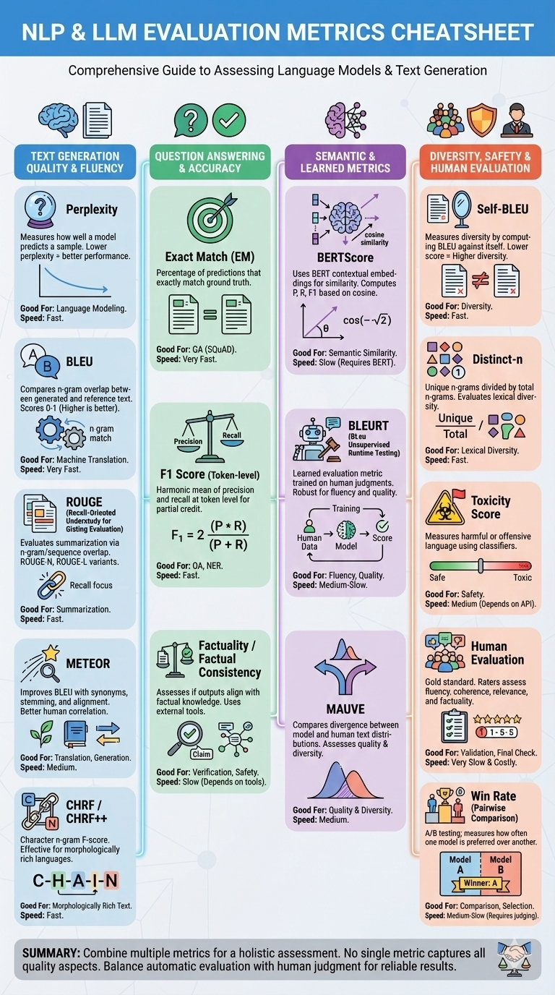
Notes:
Perplexity
Measures how well a language model predicts a sample. Lower perplexity indicates better performance. Commonly used for evaluating language modeling.
BLEU (Bilingual Evaluation Understudy)
Compares n-gram overlap between model-generated text and reference text. Widely used in machine translation. Scores range from 0 to 1, with higher values indicating better match.
ROUGE (Recall-Oriented Understudy for Gisting Evaluation)
Evaluates summarization quality by measuring overlap of n-grams, word sequences, or longest common subsequences between generated and reference summaries. ROUGE-N, ROUGE-L are common variants.
METEOR
Improves upon BLEU by incorporating synonyms, stemming, and alignment. Uses precision, recall, and F-score with better correlation to human judgment.
BERTScore
Uses contextual embeddings from BERT to compute similarity between generated and reference texts. Measures precision, recall, and F1 based on cosine similarity.
BLEURT (BLeu Unsupervised Runtime Testing)
A learned evaluation metric trained on human judgments. More robust than BLEU for evaluating fluency and quality.
CHRF / CHRF++
Character n-gram F-score, effective for morphologically rich languages. Works well when word-level overlap is low.
Exact Match (EM)
Measures the percentage of predictions that exactly match the ground truth. Common in question answering (e.g., SQuAD).
F1 Score (Token-level)
Harmonic mean of precision and recall at the token level. Used in QA and named entity recognition to measure partial credit.
MAUVE
Compares the divergence between model-generated and human-generated text distributions using statistical testing. Assesses both quality and diversity.
Self-BLEU
Measures diversity by computing BLEU score of generated texts against each other. Lower self-BLEU indicates higher diversity.
Distinct-n
Counts the number of unique n-grams in generated text divided by total n-grams. Evaluates lexical diversity.
Human Evaluation
Gold standard involving human raters assessing fluency, coherence, relevance, and factual consistency. Often used to validate automatic metrics.
Toxicity Score
Measures the presence of harmful or offensive language using classifiers (e.g., Perspective API). Important for safety evaluation.
Factuality / Factual Consistency
Assesses whether model outputs align with factual knowledge. Tools like FactScore or QA-based verification are used.
Win Rate (Pairwise Comparison)
In A/B testing, measures how often one model is preferred over another by humans or automated judges.
These metrics are often used in combination, as no single metric fully captures all aspects of language generation quality.

Slide 10
Evaluation: The ROUGE Metric
Why Accuracy doesn't work: No single "correct" summary.
ROUGE: Measures overlap of N-grams between Generated Summary and Human Reference.
ROUGE-1: Overlap of single words.
ROUGE-L: Longest common subsequence (structure).
Notes:
Good reference blog: https://galileo.ai/blog/rouge-metric

Slide 11
The Hallucination Danger
Example:
Source: "The robot battery is at 10%."
Bad Summary: "The robot is fully charged."
Mitigation:
Fact-Checking layers (Natural Language Inference).
Low Temperature (Reducing creativity).

Slide 12
The Fine-Tuning Problem
Context: Customizing Llama-3-8B to speak like a pirate.
Full Fine-Tuning:
Requires updating all 8B weights.
Requires ~120GB+ VRAM (Do you have 4 A100 GPUs?).
The Solution: PEFT (Parameter-Efficient Fine-Tuning).
Notes:
For detailed explanations refer: https://cameronrwolfe.substack.com/p/easily-train-a-specialized-llm-peft

Slide 13
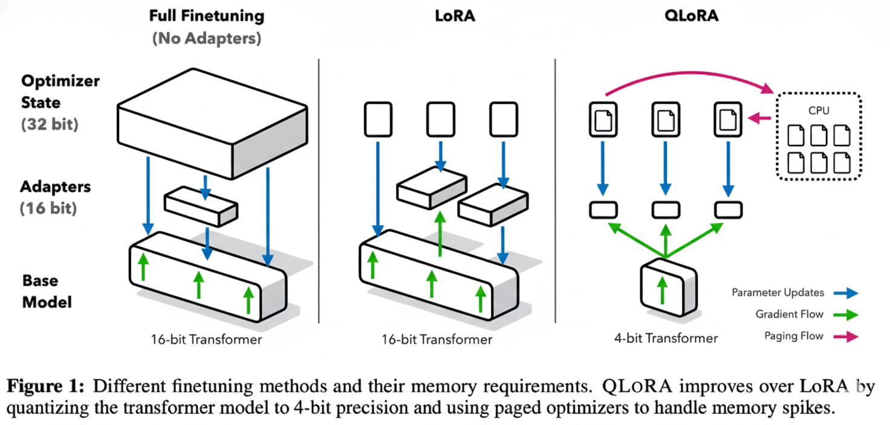
Source: https://arxiv.org/pdf/2305.14314

Slide 14
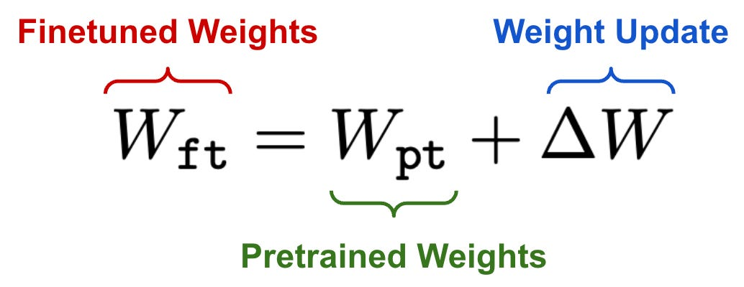
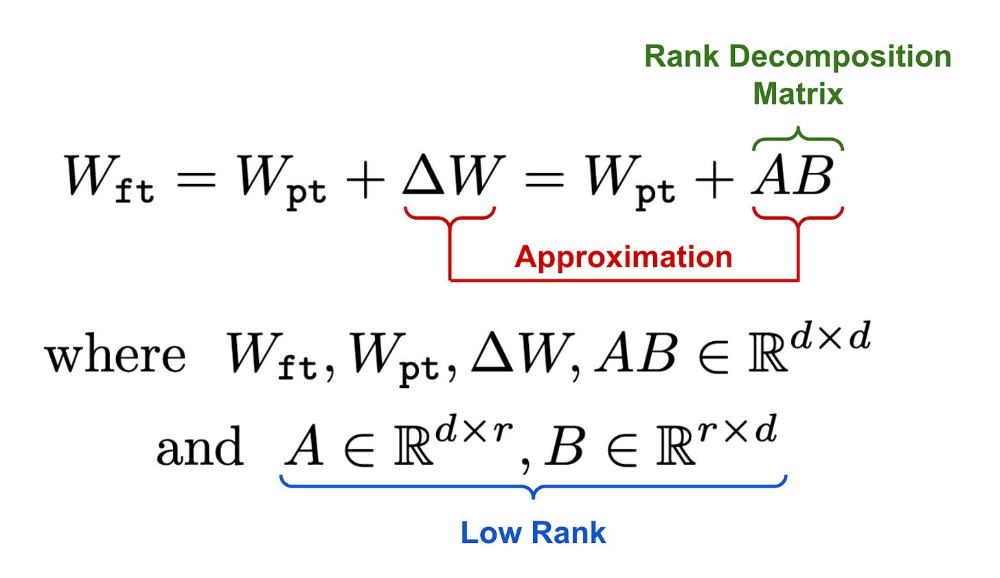
Enter LoRA (Low-Rank Adaptation)
The Insight: We don't need to change every weight. The required change is low-rank.
How it works:
Freeze the massive pre-trained model (W).
Inject two tiny matrices (A and B) next to layers. Train only A and B.
Math: W_new = W_frozen + (B x A)
Image Credit: https://cameronrwolfe.substack.com/p/easily-train-a-specialized-llm-peft
Notes:
Refer Practical Tips for fine-tuning LLM: https://magazine.sebastianraschka.com/p/practical-tips-for-finetuning-llms

Slide 15
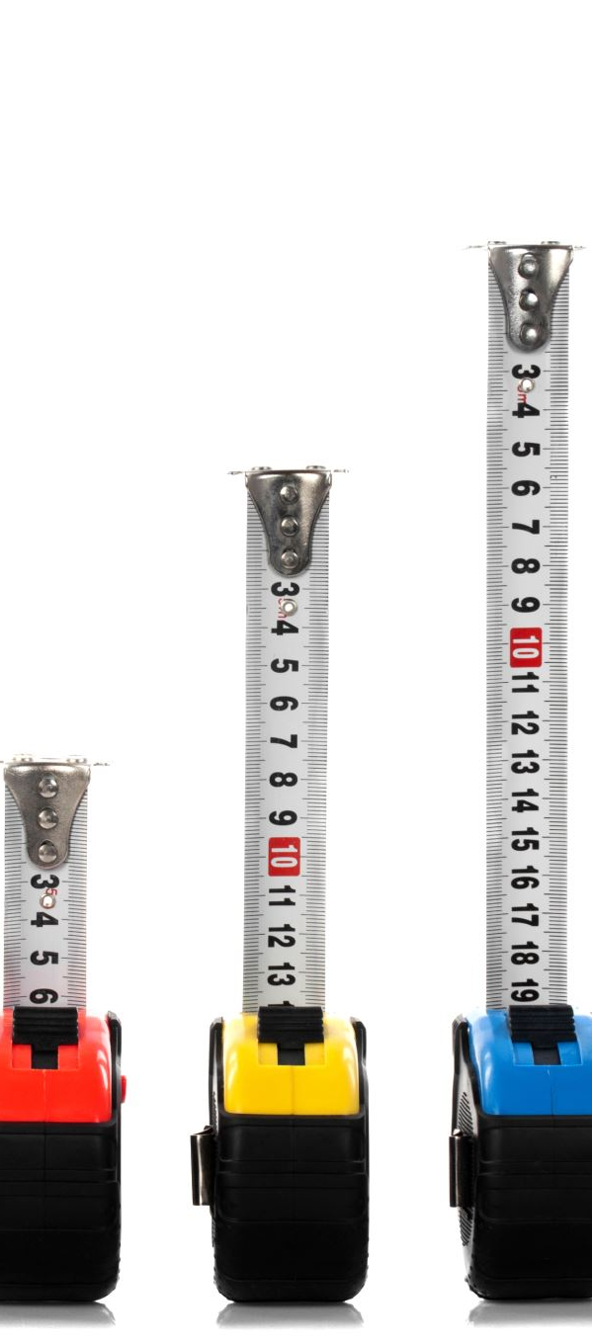
The Efficiency Gains
Storage: Full Llama-3 Checkpoint = 15GB. LoRA Adapter = 20MB.
Memory: Train a 7B model on a single consumer GPU (RTX 4090 / Colab).
Modularity: Swap adapters instantly.
Adapter 1: Medical Docs. Adapter 2: Legal Docs.
Base Model: Stays the same.

Slide 16
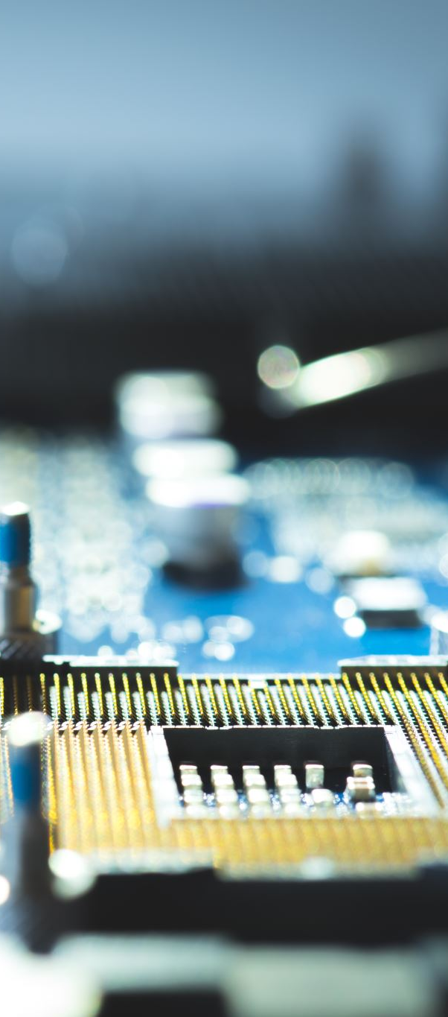
QLoRA (Quantized LoRA)
2025 Standard:
Quantization: Load base model in 4-bit to save memory.
LoRA: Apply the adapter on top.
Result: Fine-tuning SOTA models on consumer hardware.

Slide 17
Adapters in Robotics
The "Skill Store" Concept:
Robot Base Brain: General Language Understanding.
LoRA Module A: Navigation Syntax.
LoRA Module B: Tool Manipulation Manual.
*The robot loads the specific LoRA adapter based on the task at hand.*

Slide 18
Lab Overview
Part 1: Decoding Playground
Use model.generate() with different settings (Temp 0.1 vs 2.0).
Observe how Beam Search fixes grammar errors.
Evaluate using cheat sheet.
Part 2: LoRA Fine-Tuning
Task: Fine-tune base model (flan-t5/TinyLlama) to summarize Dialogues.
Tool: Hugging Face PEFT library.
Notes:
CODE SNIPPET 1: Controlling Generation
model.generate(
inputs,
max_new_tokens=20,
do_sample=True,
top_p=0.92,
temperature=0.8
)
CODE SNIPPET 2: LoRA Config
peft_config = LoraConfig(
task_type=TaskType.SEQ_2_SEQ_LM,
r=8,
lora_alpha=32,
lora_dropout=0.1
)
model = get_peft_model(original_model, peft_config)

Slide 19
Summary
Control: Use Nucleus Sampling for creativity, Beam Search for accuracy.
Efficiency: Never full fine-tune. Use LoRA/PEFT.
Future: Adapter Fusion (combining skills).

Slide 20
References & Reading
Holtzman et al. (2019). "The Curious Case of Neural Text Degeneration" (Nucleus Sampling). https://arxiv.org/abs/1904.09751
Hu et al. (2021). "LoRA: Low-Rank Adaptation of Large Language Models".
MIT Paper on Chain of Density Prompting (2023).
Hugging Face PEFT Index
Next Week: Module 7 - RAG Systems RAG Survey (2023) - https://arxiv.org/pdf/2312.10997

